Slide 1
Adaptive sampling of ocean fronts with multiple AUVs
Trial lecture
Ph.D. Candidate: Yaolin Ge
Date of the trial lecture: 2024-05-08
Department of Mathematical Sciences
Faculty of Information Technology and Electrical Engineering

Slide 2
Agenda
Ocean fronts
Autonomous Underwater Vehicles (AUVs)
Adaptive sampling
Case studies
Remarks
Conclusion

Slide 3
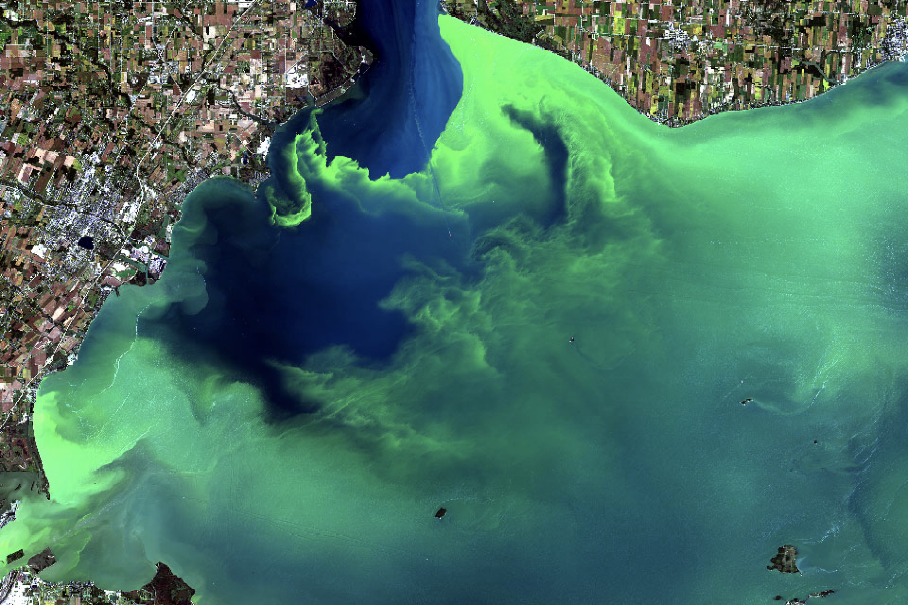
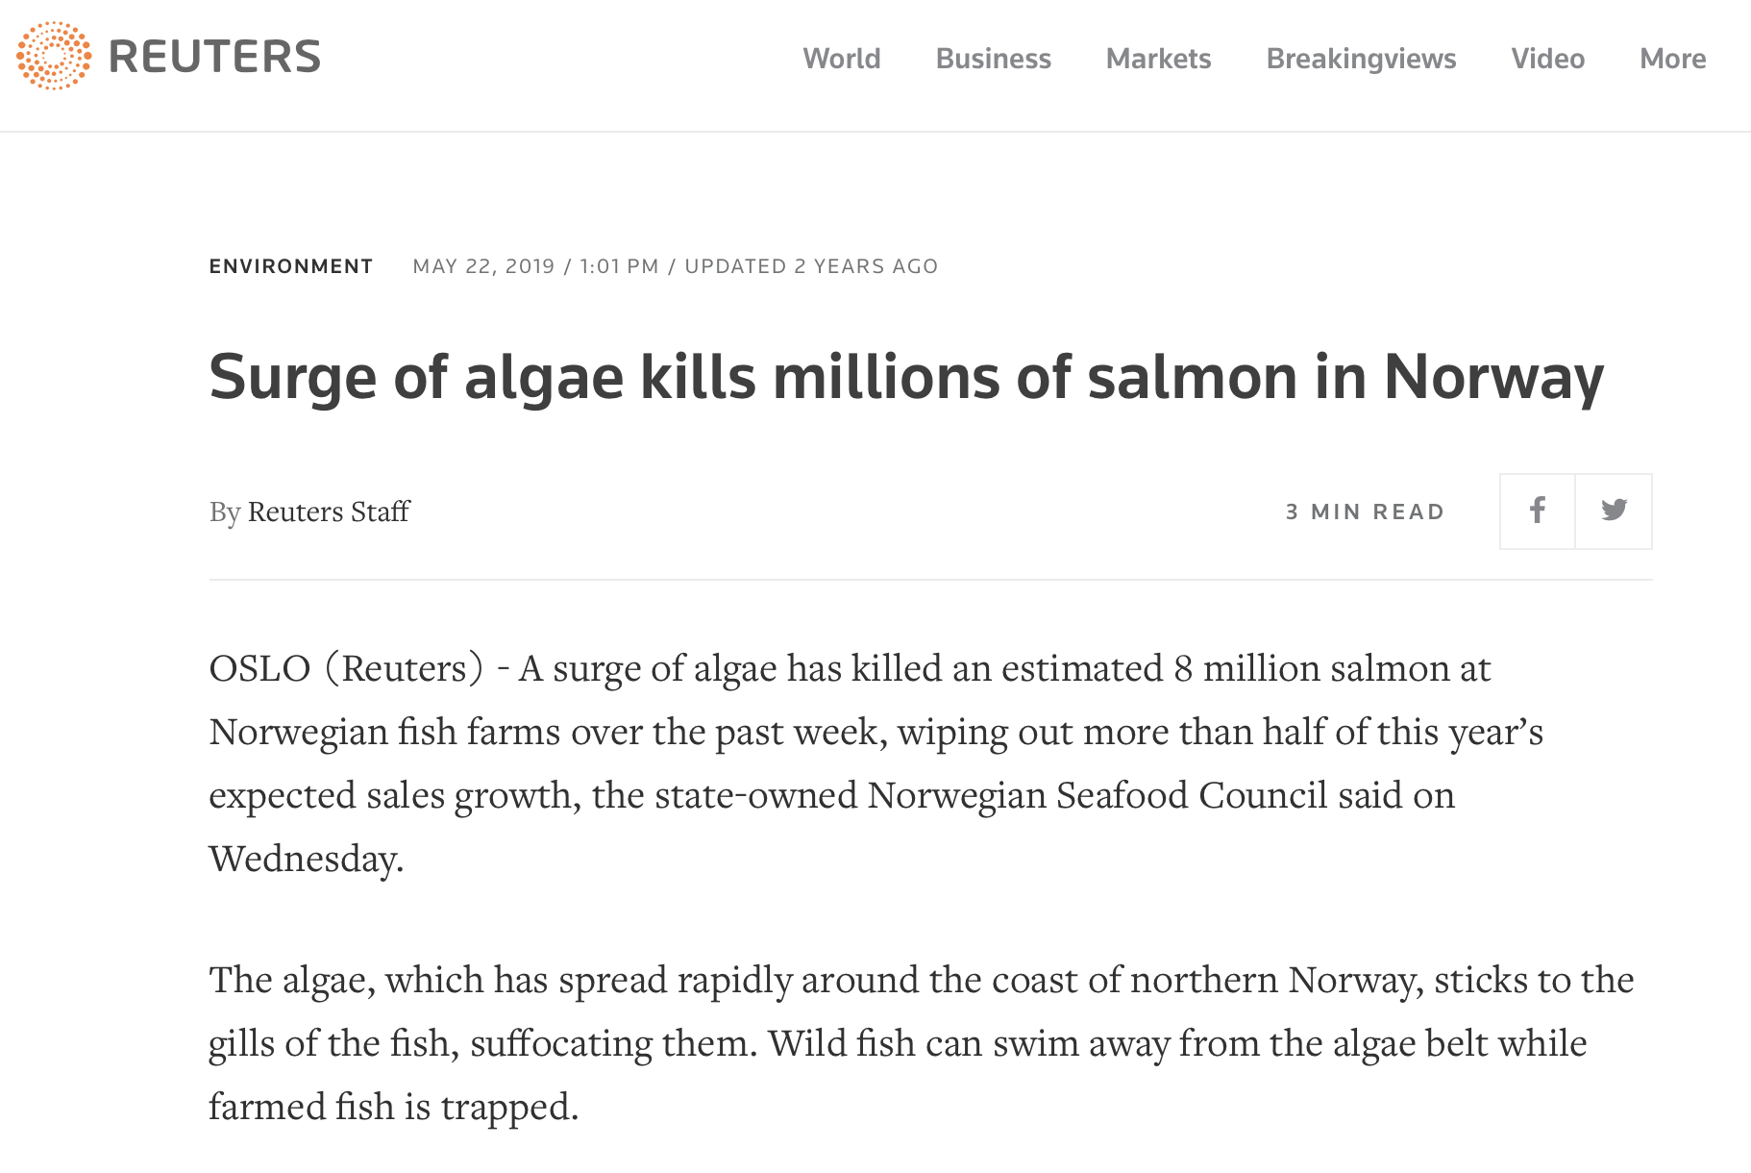
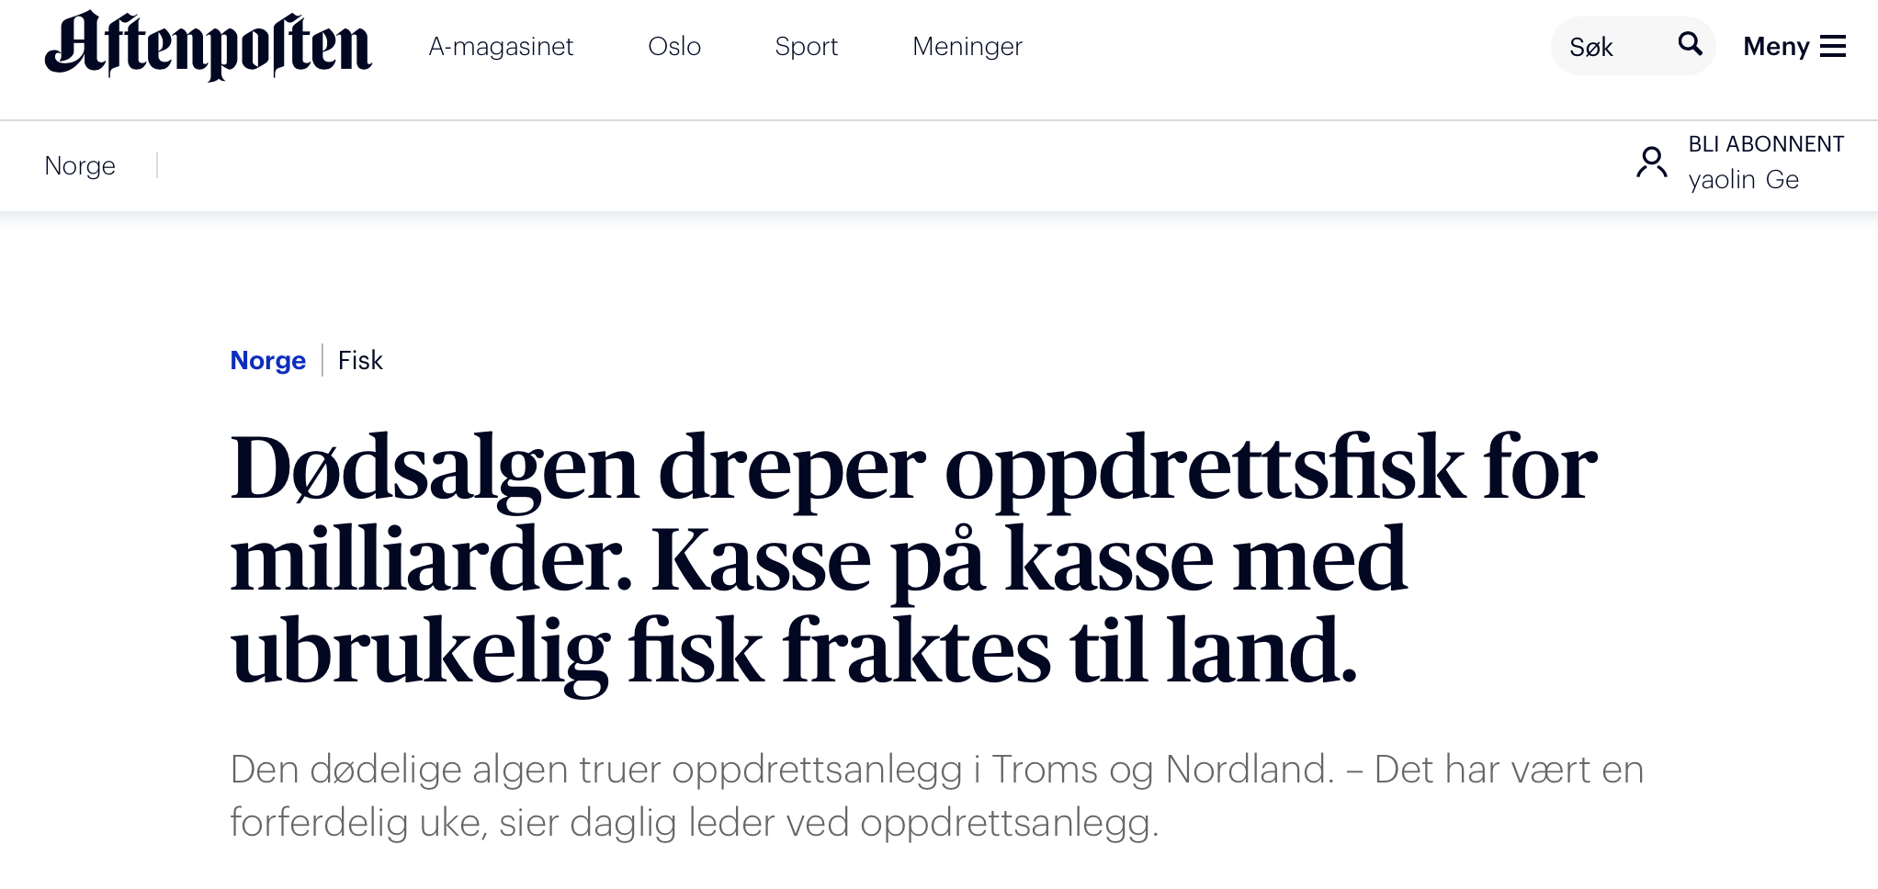
Ocean fronts
What is oceanfront?
Why is it important in the ecosystem and climate?

Slide 4
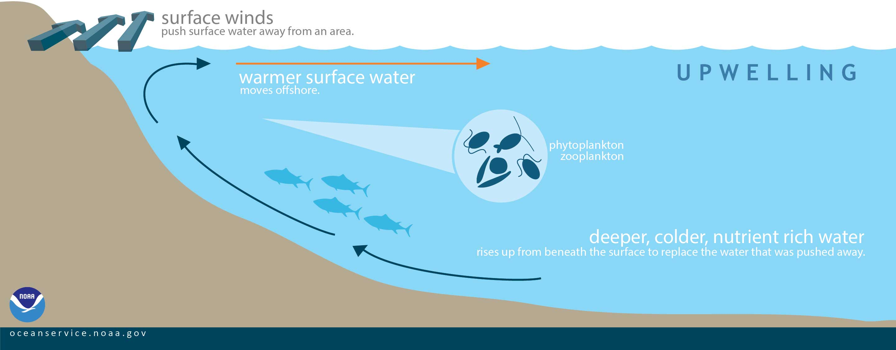
Ocean fronts (upwelling)

Slide 5
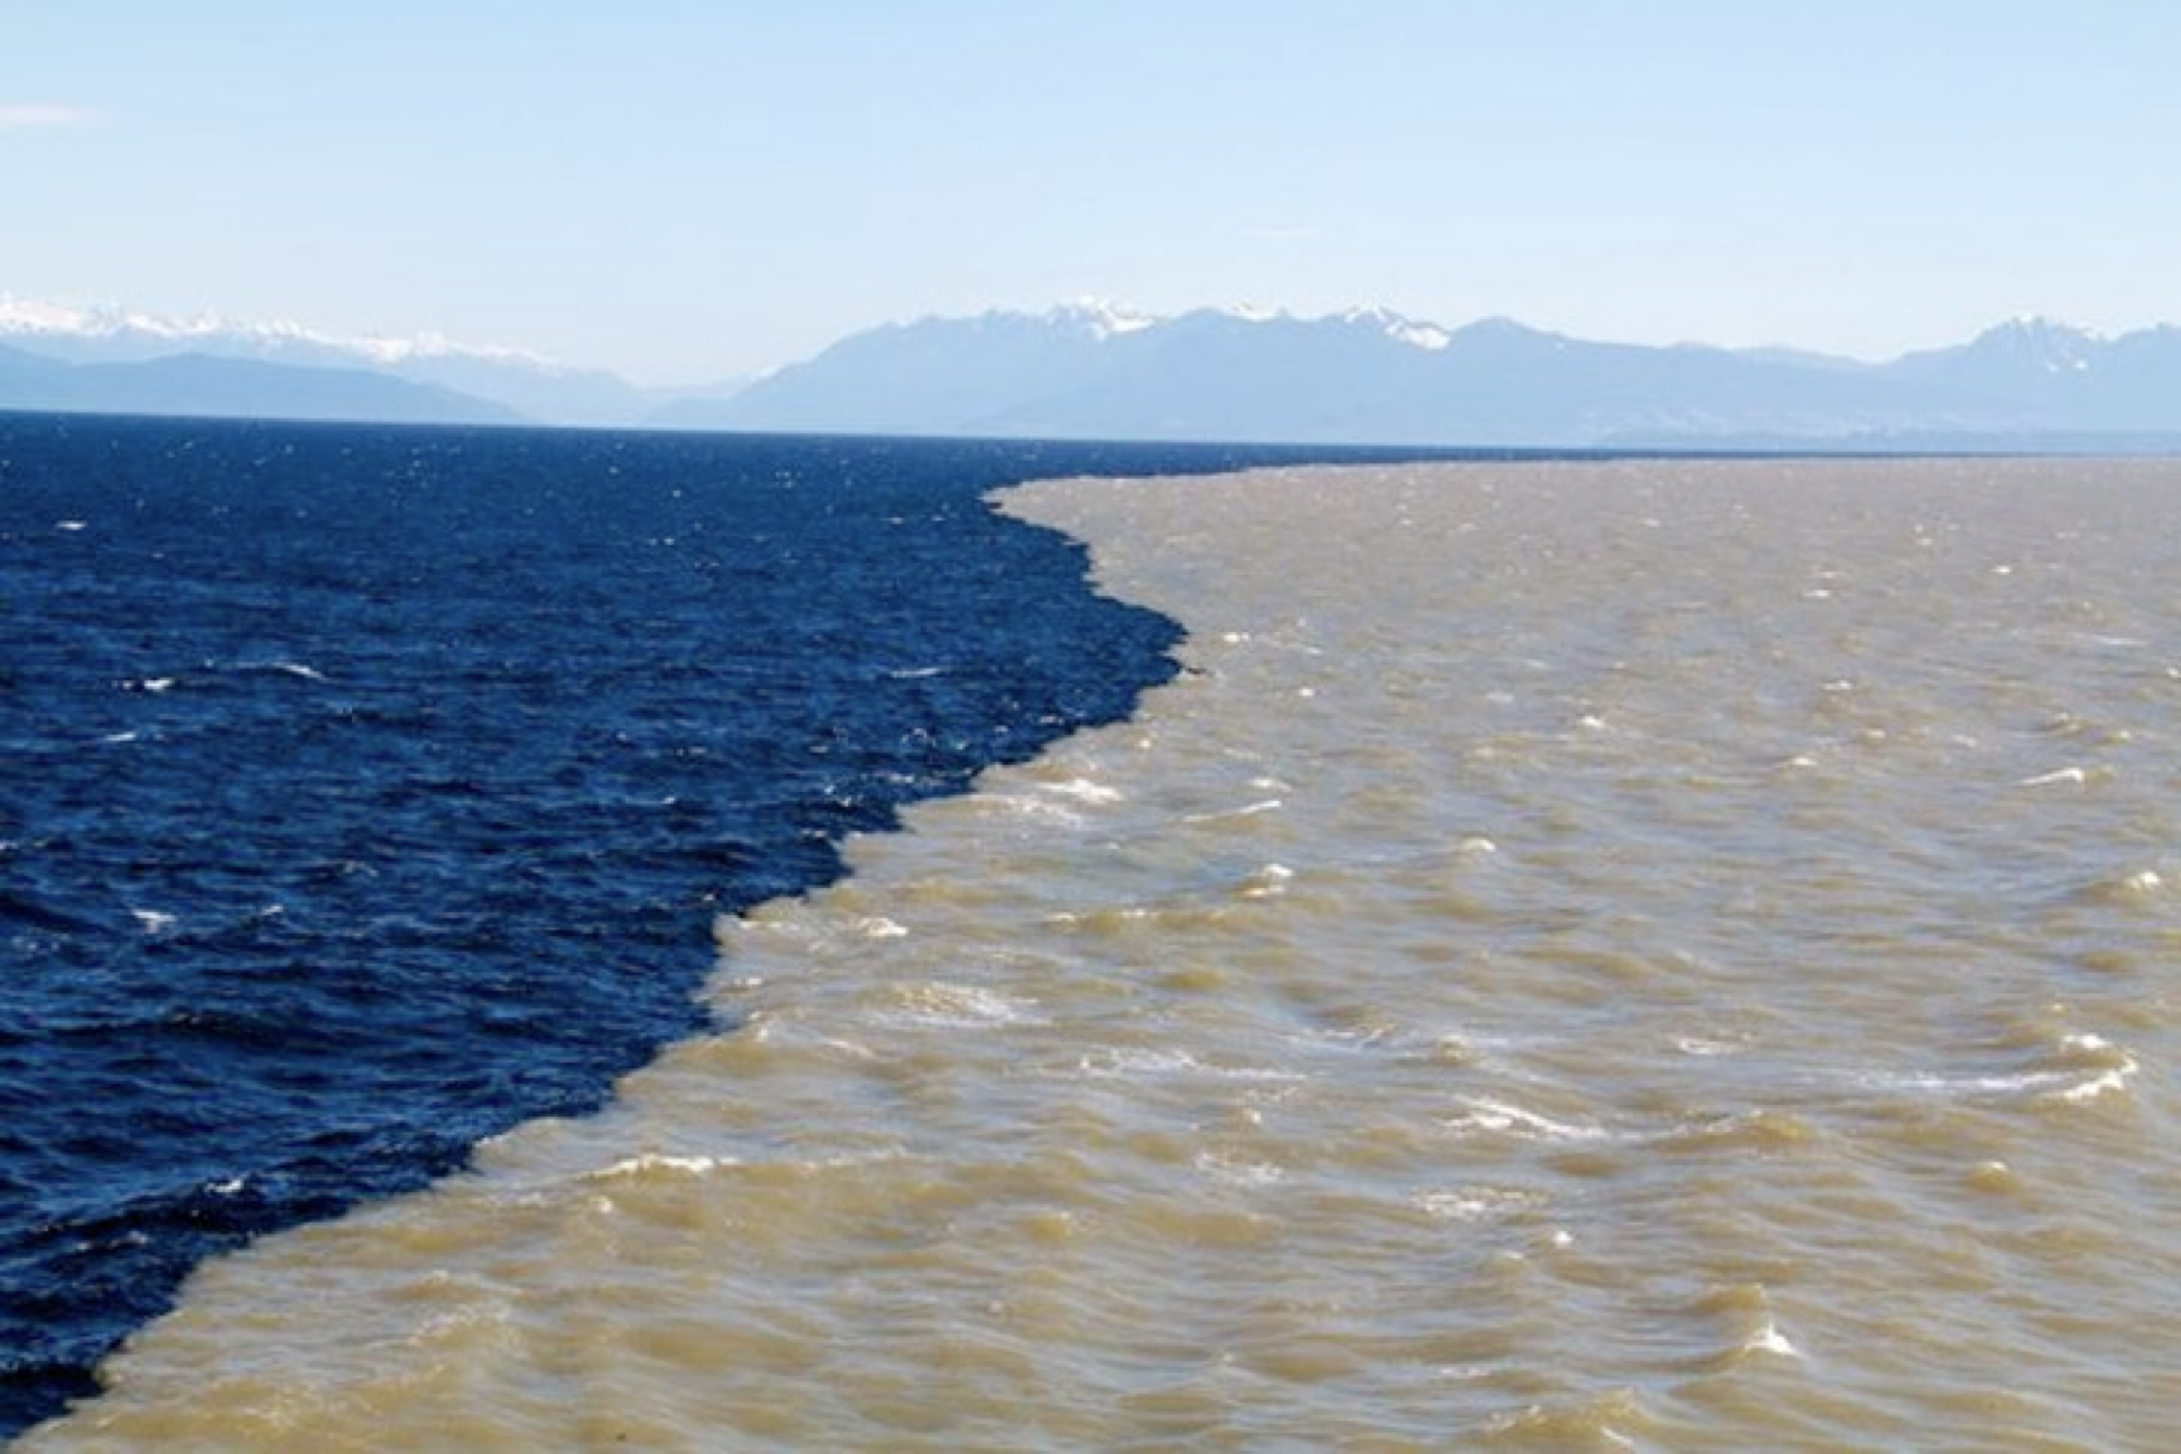
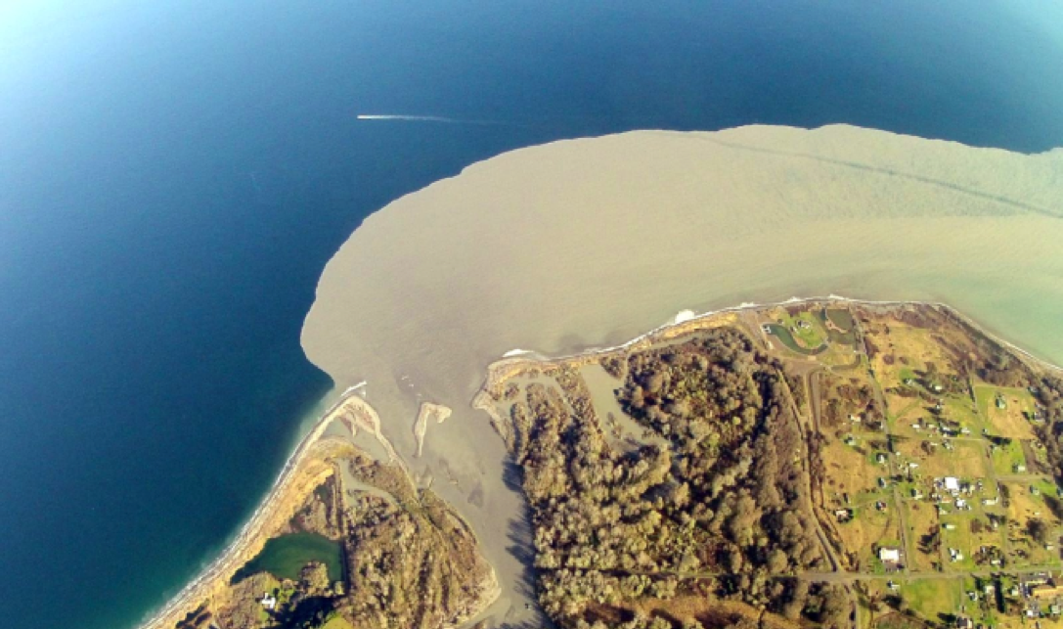
Ocean fronts (surface plume)
Fraiser River, Vancouver, Canada (@PEACE ARCH NEWS)
Elwha River (@University of Washington)

Slide 6
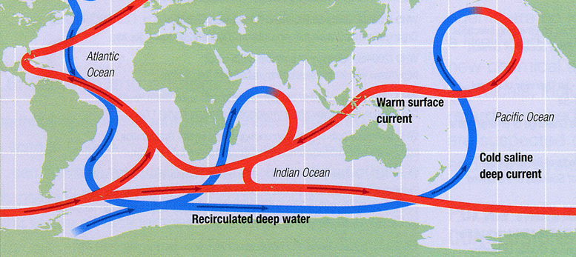
Ocean fronts (thermohaline)
Source: Ginny Brown, National Council for Science and the Environment

Slide 7
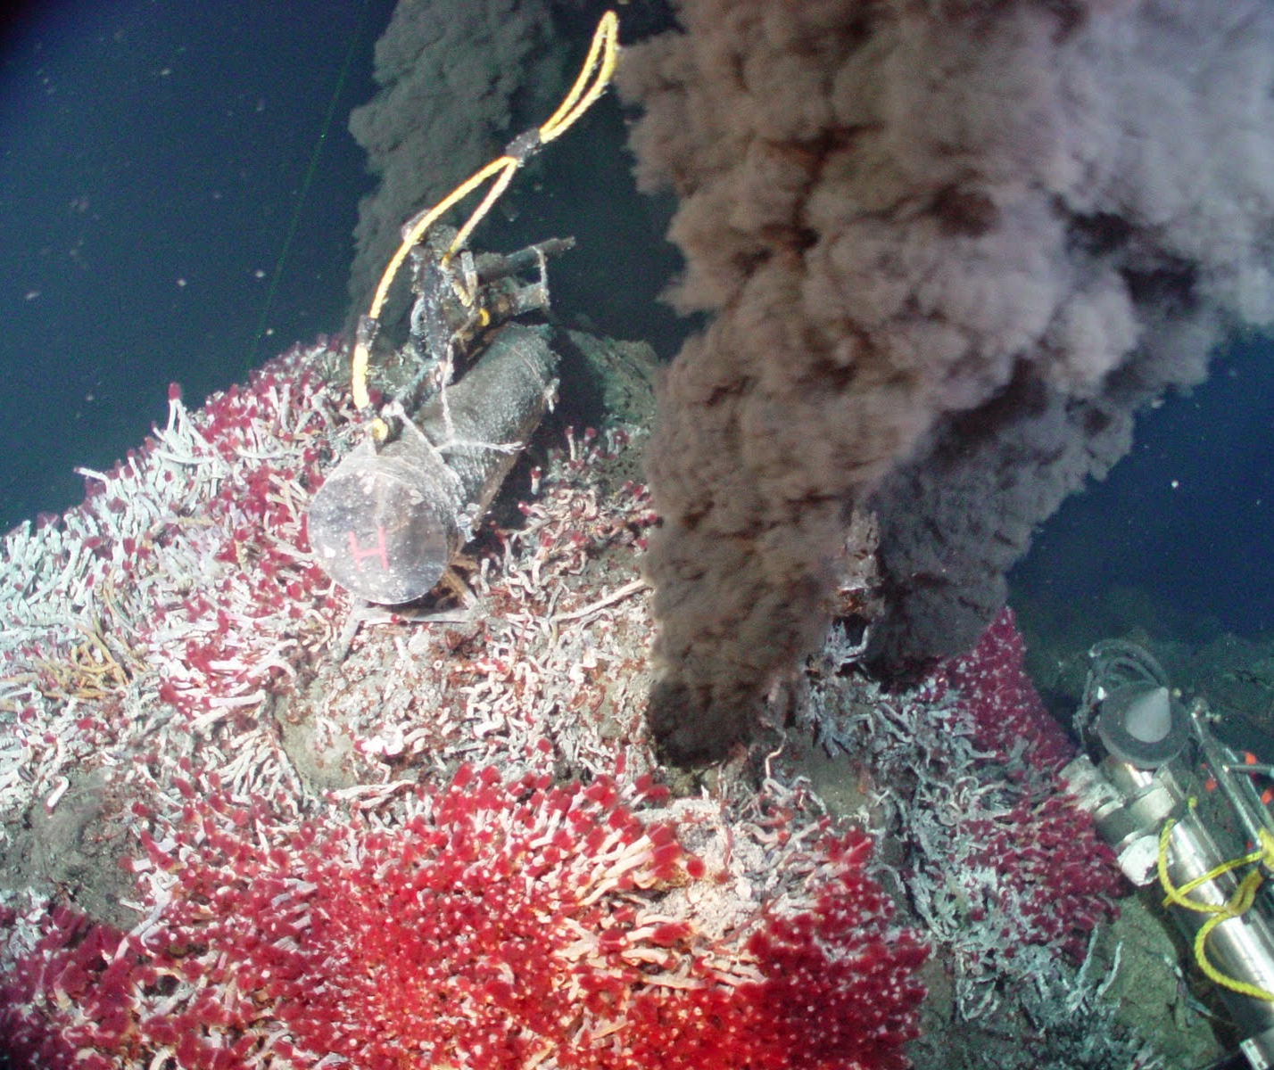
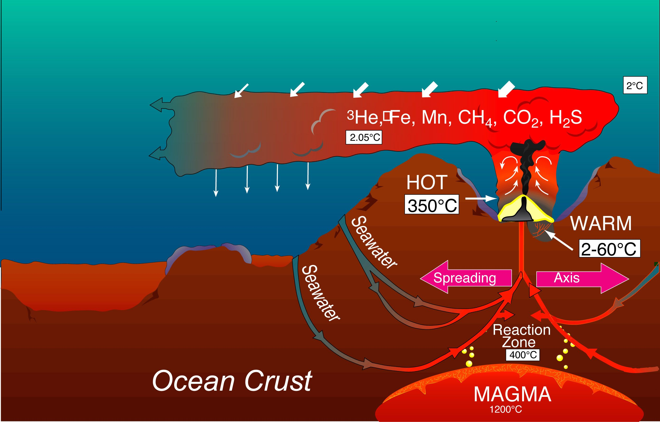
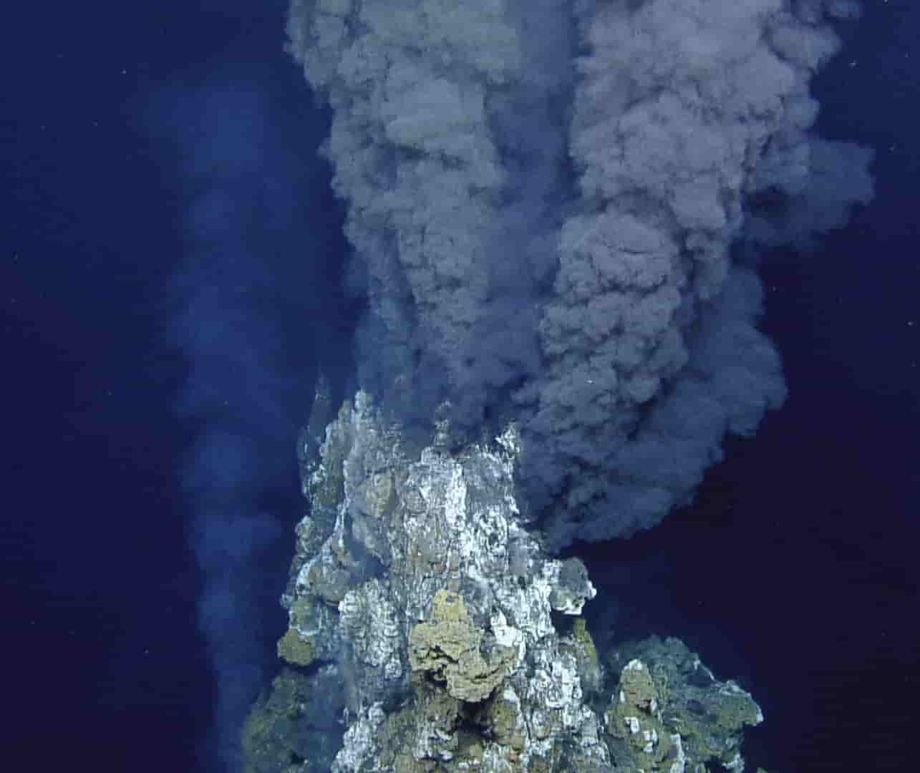
Ocean fronts (hydrothermal vents)
Source: Woods Hole Oceanographic Institution

Slide 8
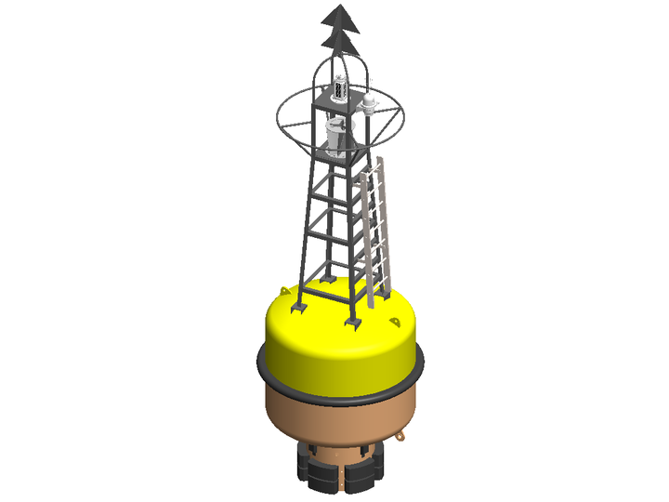
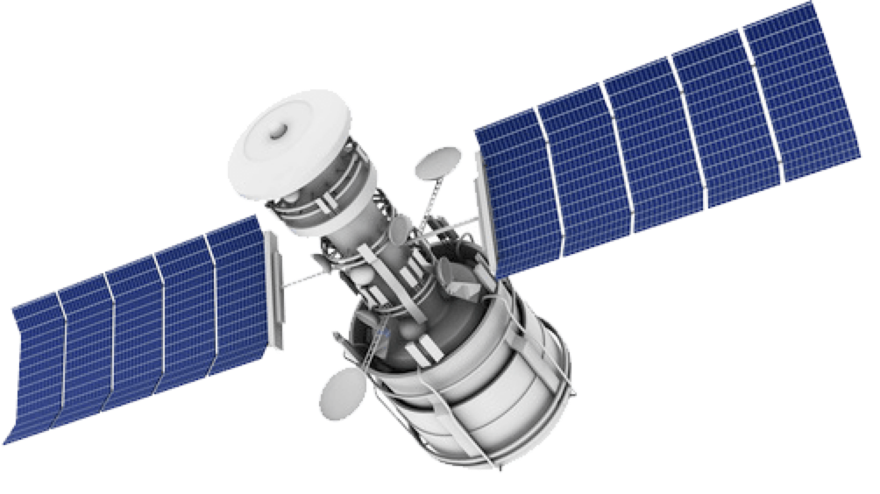
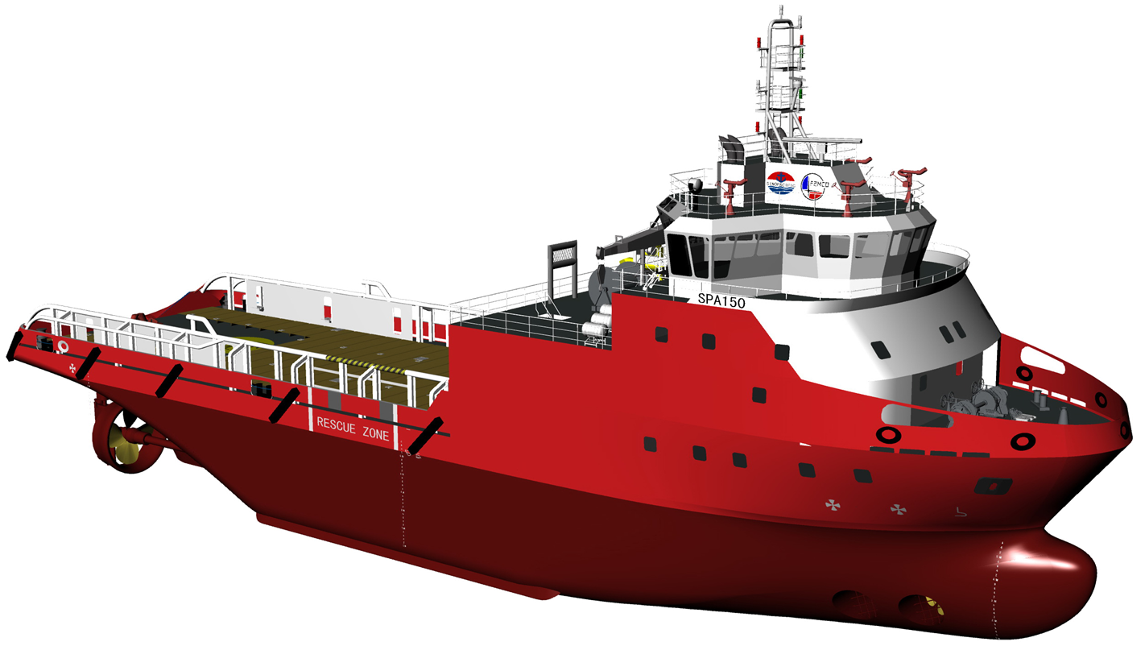
Ways of monitoring
Can provide large-scale view
Only limited on surface
Can carry many instruments
Expensive and limited by weather
Ideal for long-term monitoring
Not so flexible

Slide 9
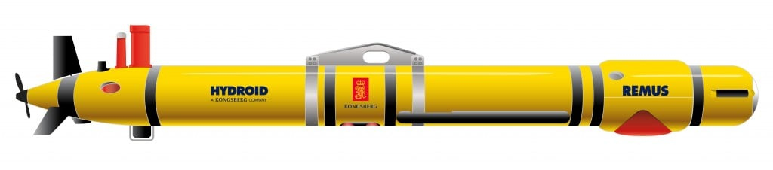
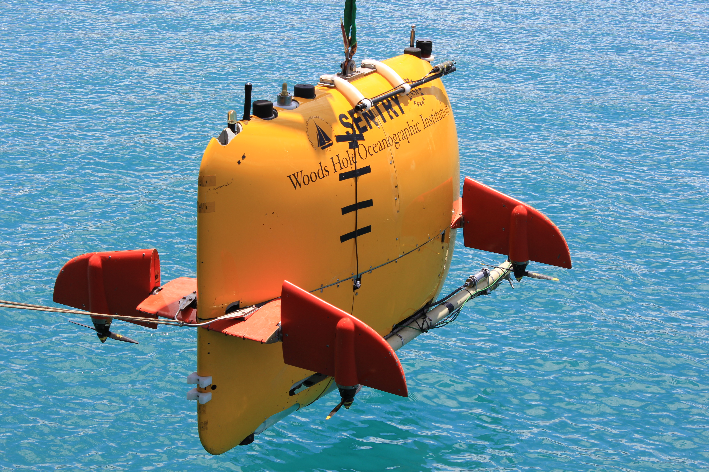
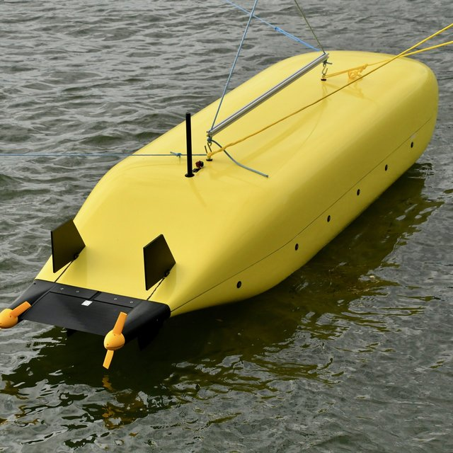
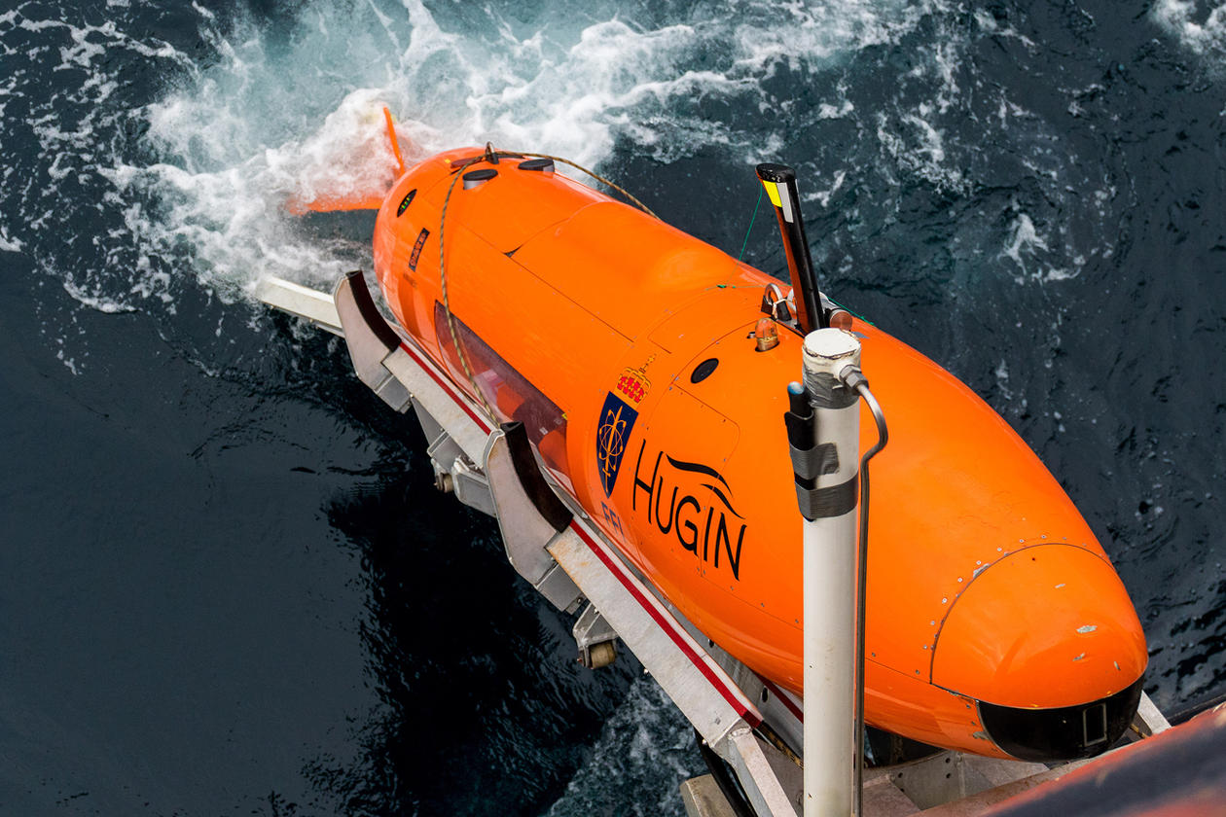
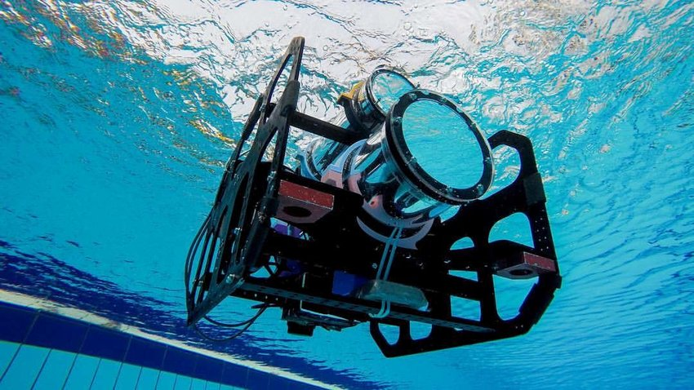
Autonomous Underwater Vehicles
What is AUV?
Why is it useful?
1
2
3
4
Notes:
Hugin can dive to 6000 meter for 100 hours
High Spatial and Temporal Resolution:

Slide 10
Why AUV?
High Spatial and Temporal Resolution
Adaptive Sampling Capabilities
Cost Efficiency
Access to Remote and Harsh Environments

Slide 11
Adaptive sampling
Definition
Dynamically adjusting the data collection strategy based on real-time data.
Optimizes resource use and improves data relevance.
Key features
Real-time Data Analysis
Dynamic Decision-Making
Efficient Resource Use
Advantages?
Efficiency
Complex environment suitability

Slide 12
Challenges in oceanfront sampling
Environmental factors
Unpredictable currents and turbulence
Dynamic and complex environment
Technical challenges
Navigation and localization in underwater
Data transmission and coordination

Slide 13
Benefits of using multiple AUVs
Coordination and control strategies
Swarm intelligence and decentralized control
Pre-programmed routes vs. dynamic programming
Communication and Collaboration
Underwater communication
Real-time data sharing

Slide 14
Case studies
Different control strategies
Different communication strategies
Different targeting strategies

Slide 15
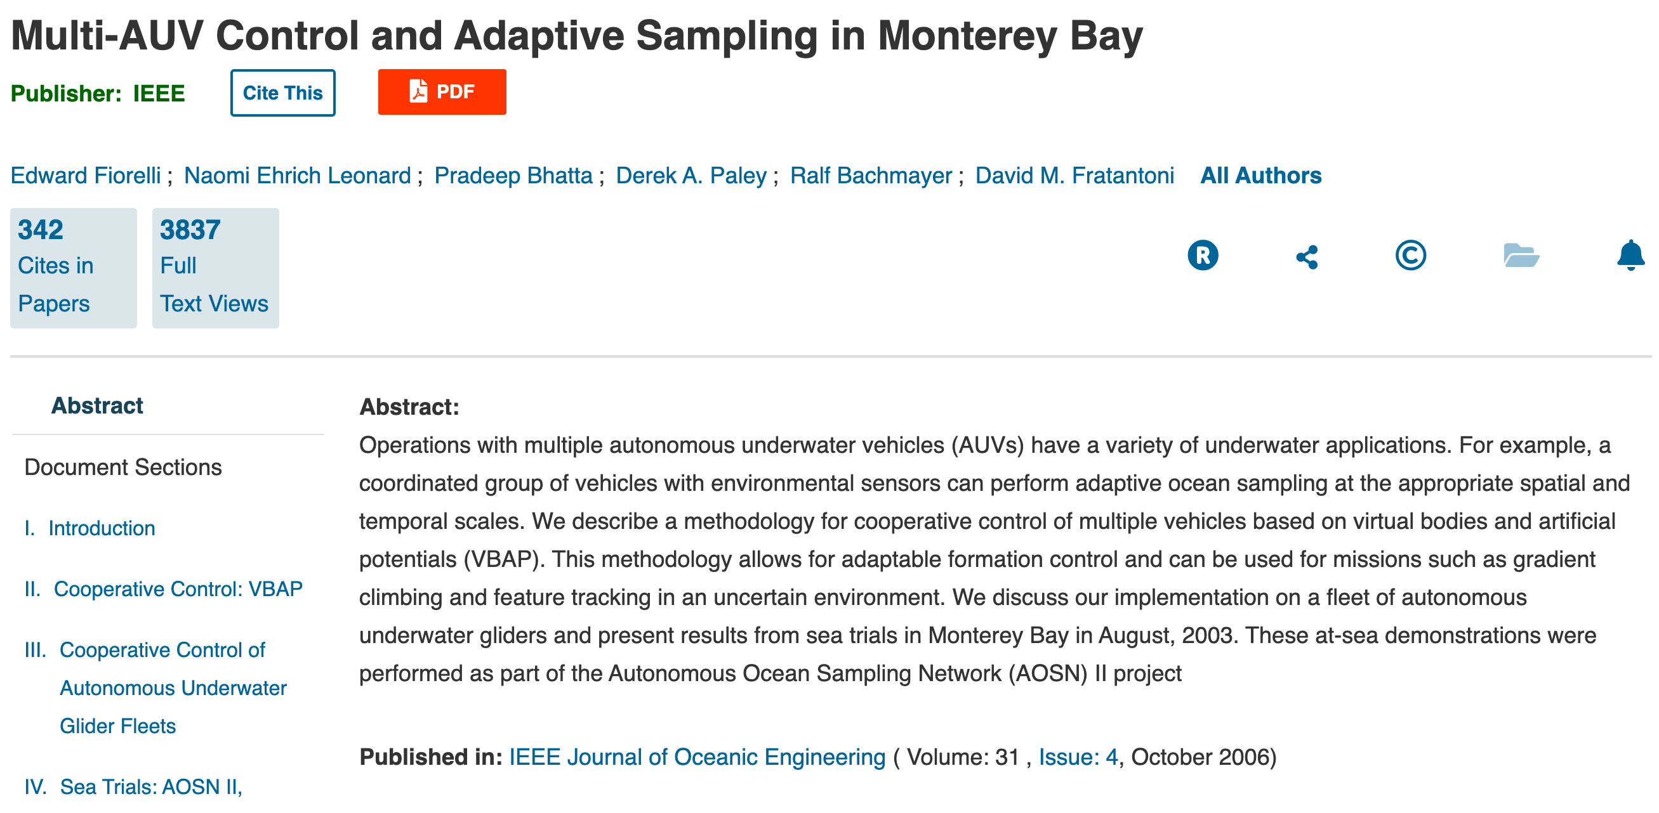
Case study I - Control of multi-AUVs

Slide 16
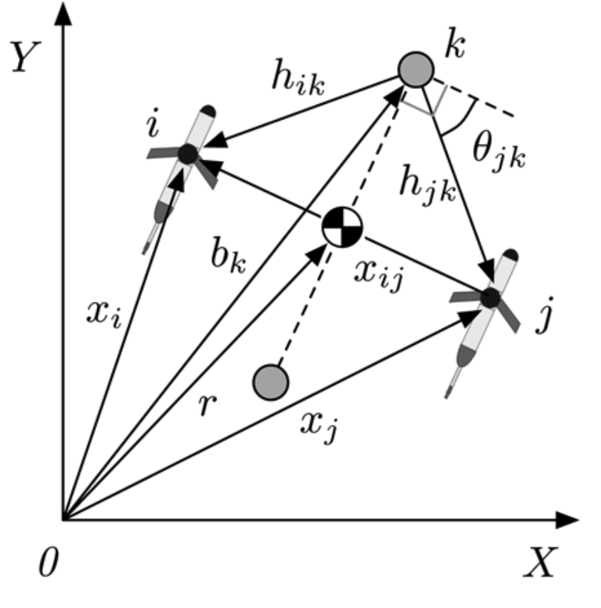
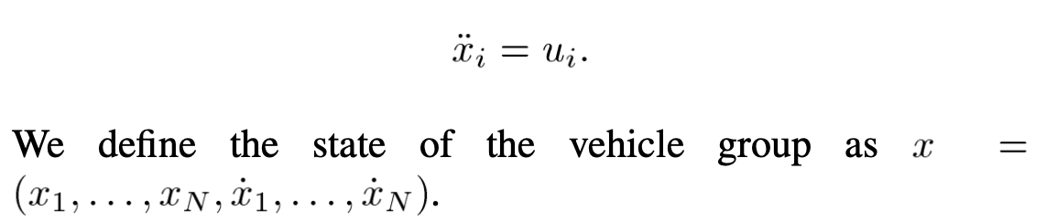
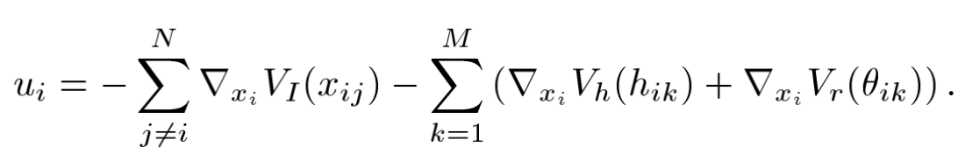
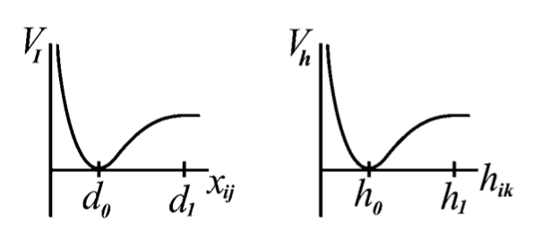
Case study I - VBAP

Slide 17
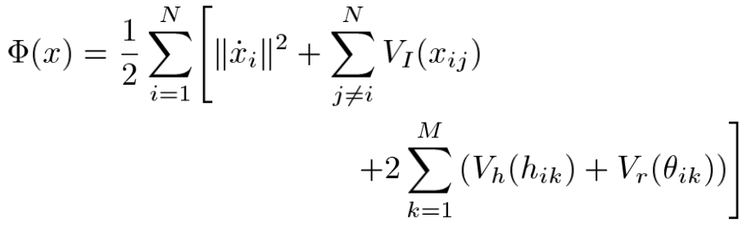
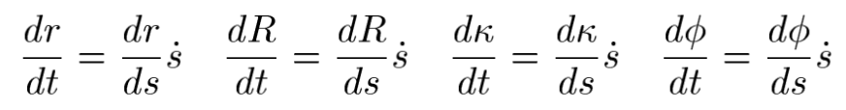
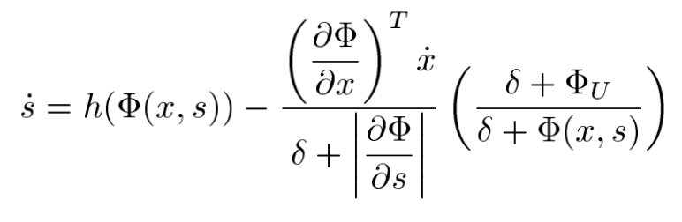
Case study I – Lyapunov function
Notes:
Formation error function,
r – position vector
R – orientation (angle of rotation in the plane)
k is scalar dilation factor
Phi – to fix additional degrees of freedom

Slide 18
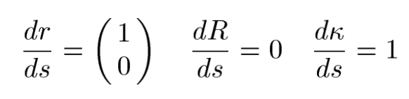
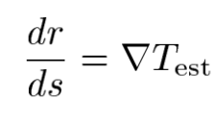
Case study I - Strategies
Stability and convergence of the formation
Feedback control based on the measurements
Notes:
1, expands over time, center moving in a straight line in the horizontal direction but its orientation is fixed, this is independent of chiose of group mission
2, each vehicle can measure any scalar environmental field T (temperature, salinity, biomass concentration).

Slide 19
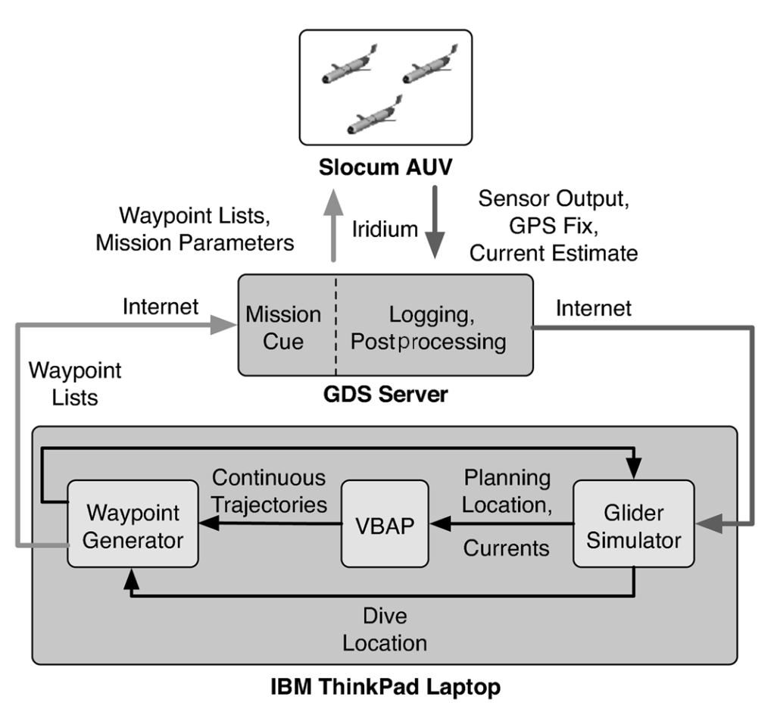
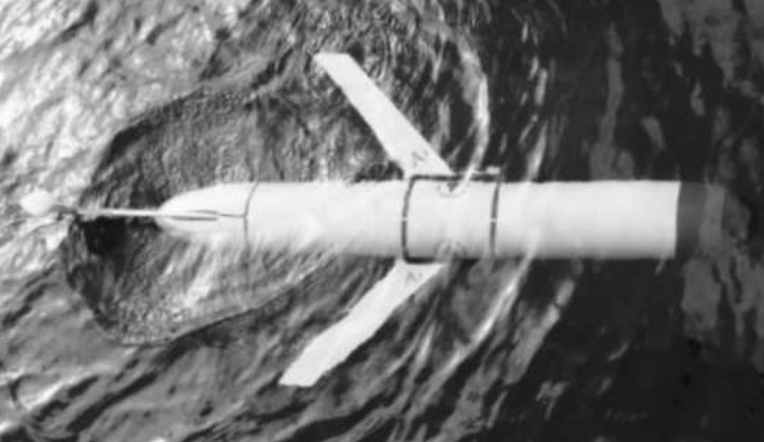
Case study I – Experiment setup
Slocum glider
Notes:
It can control the buoynacy to dive down to 100m
The current is estimated based on the GPS fix and its estimated state
No data transmission happening underwater

Slide 20
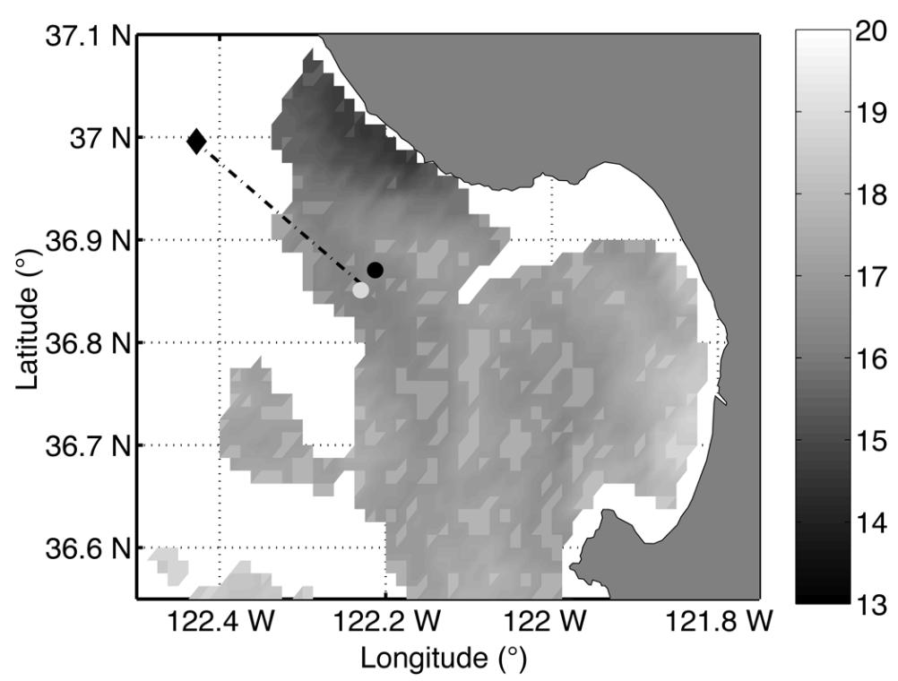
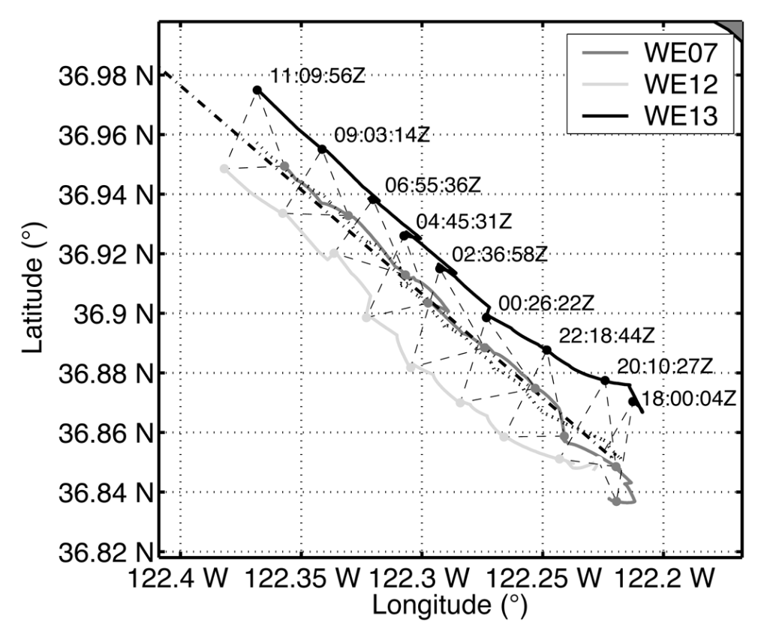
Case study I - Experiment
Glider formation at Upwelling event.

Slide 21
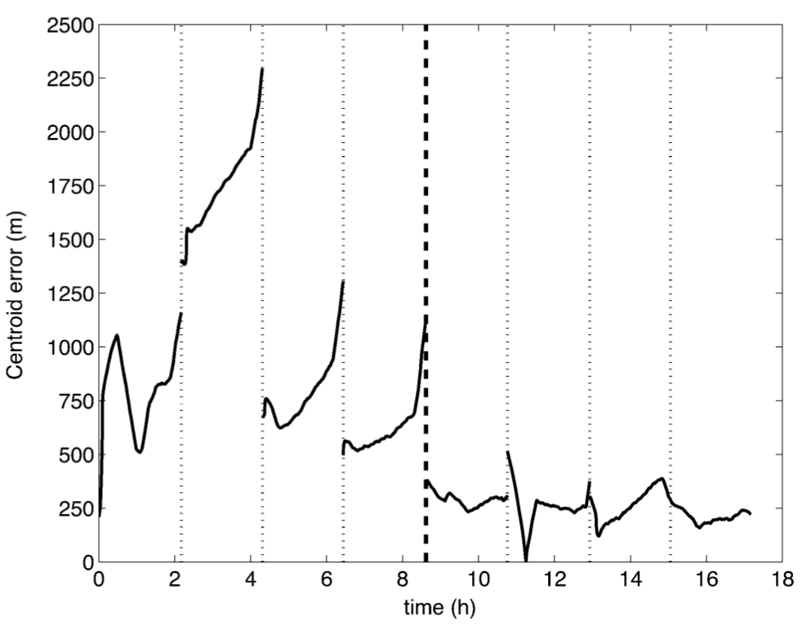
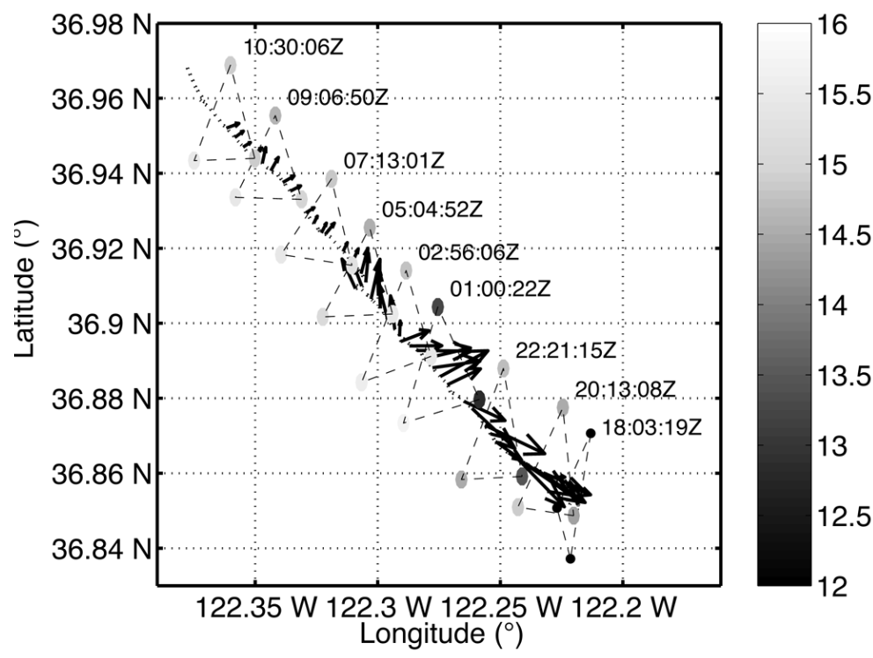
Case study I - Result analysis

Slide 22
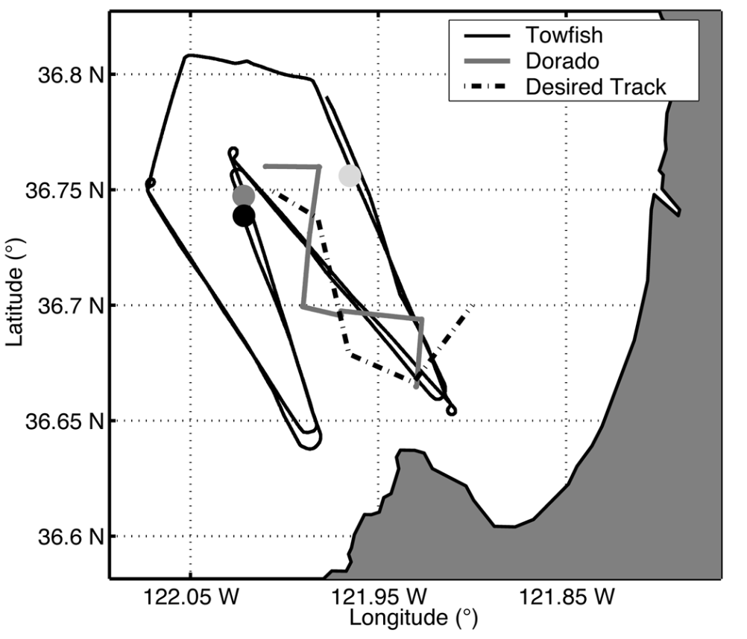
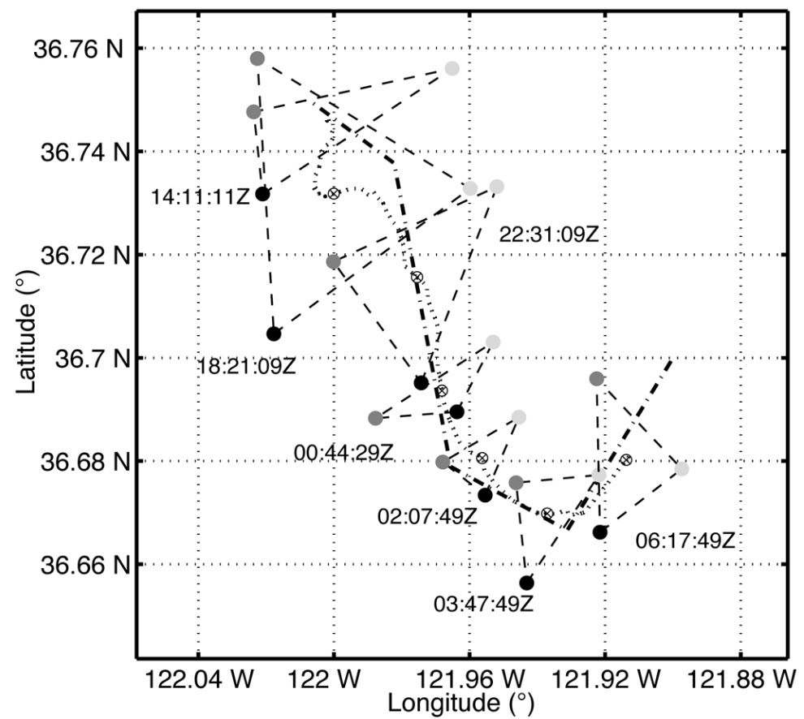
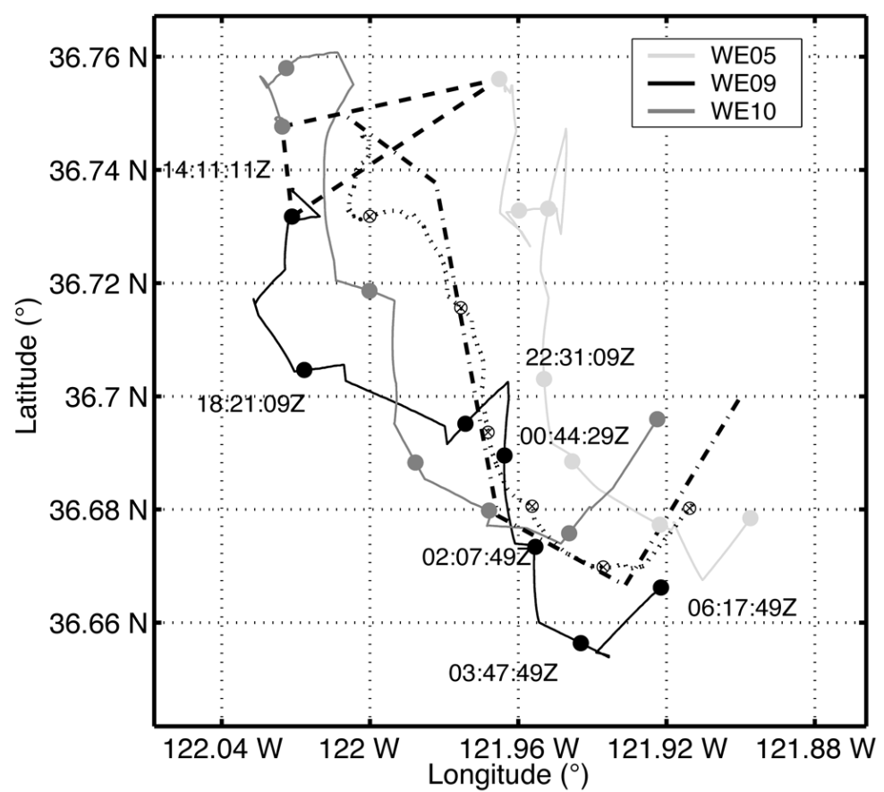
Case study I - Experiment
Multiasset demonstration

Slide 23
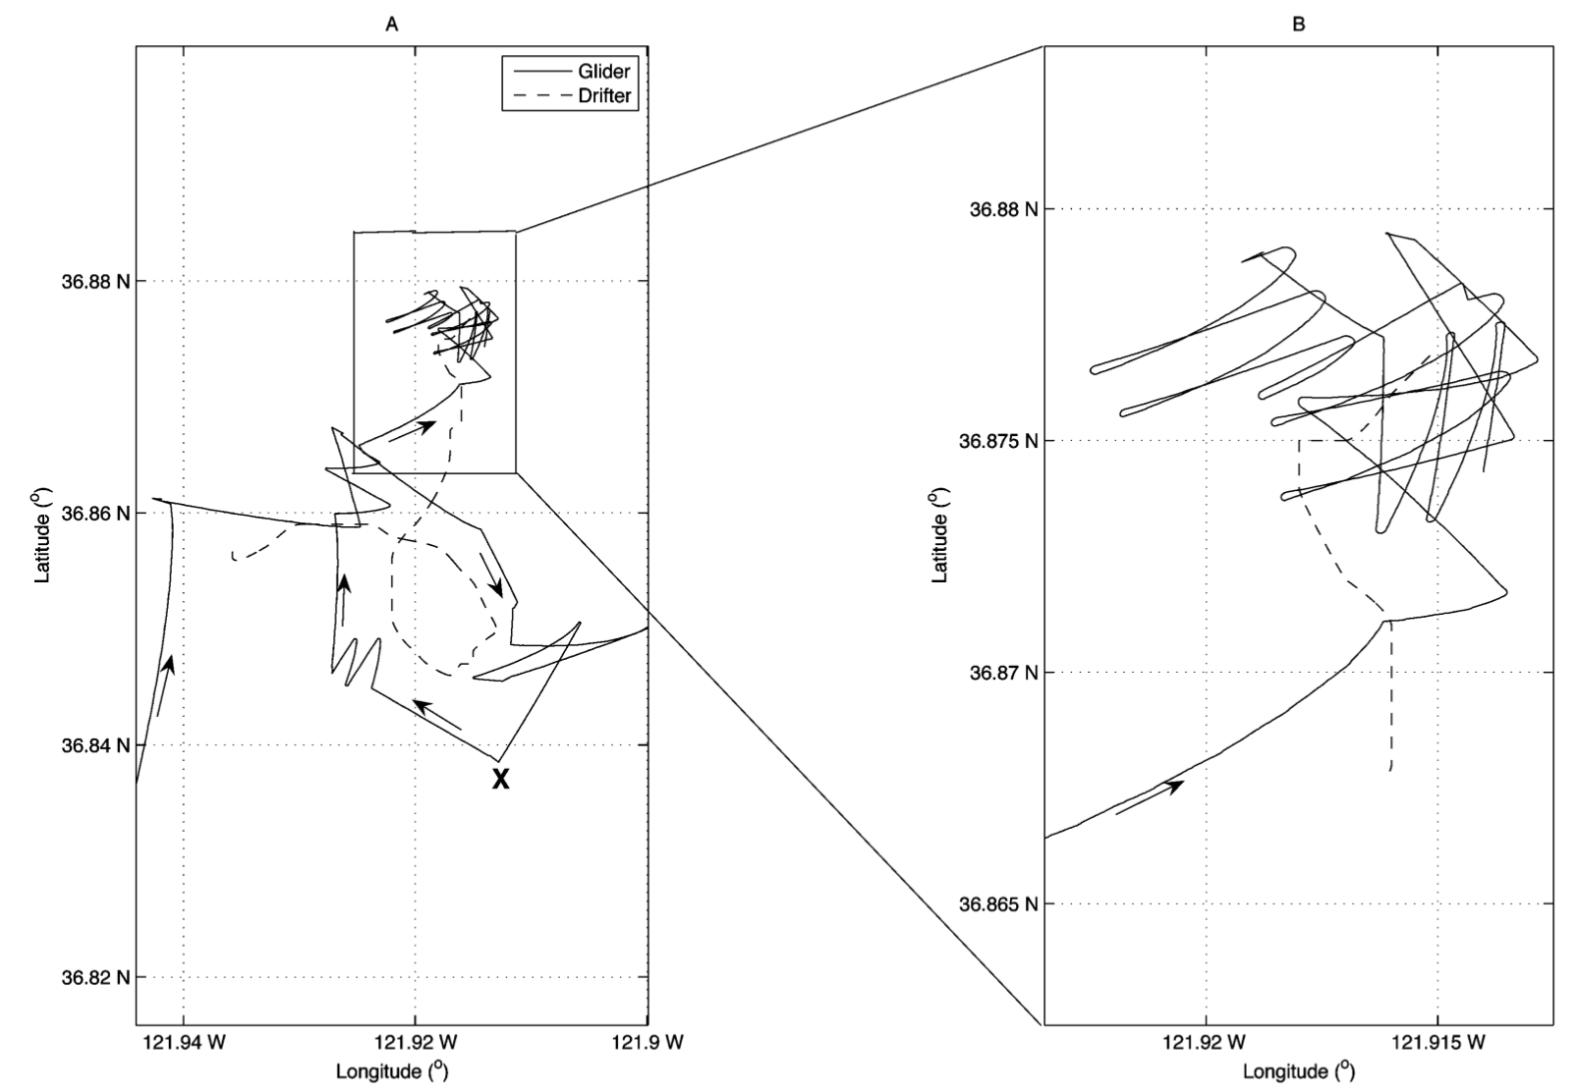
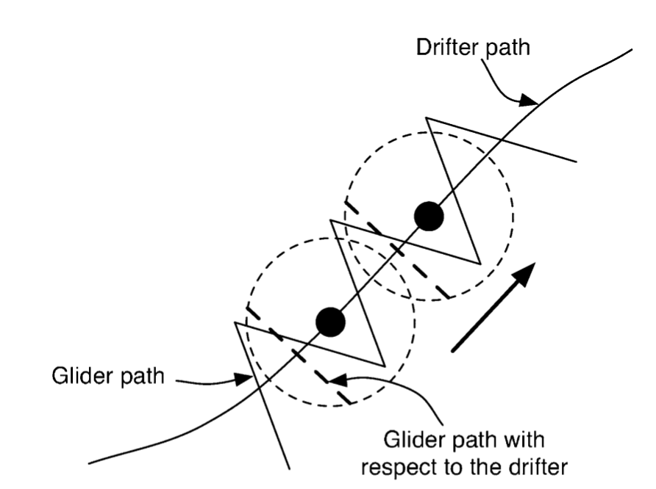
Case study I - Experiment
Drifter tracking

Slide 24
Case study I - Remarks
VBAP is proven to be effective in controlling multiple AUVs
Sea trials in Monterey Bay demonstrated that VBAP could main formations, manage orientations, and control inter-vehicle spacing with reasonable accuracy
VBAP enables adaptive sampling for gradient climbing and feature tracking
Future work could focus on the tidal effects and varying currents effects.

Slide 25
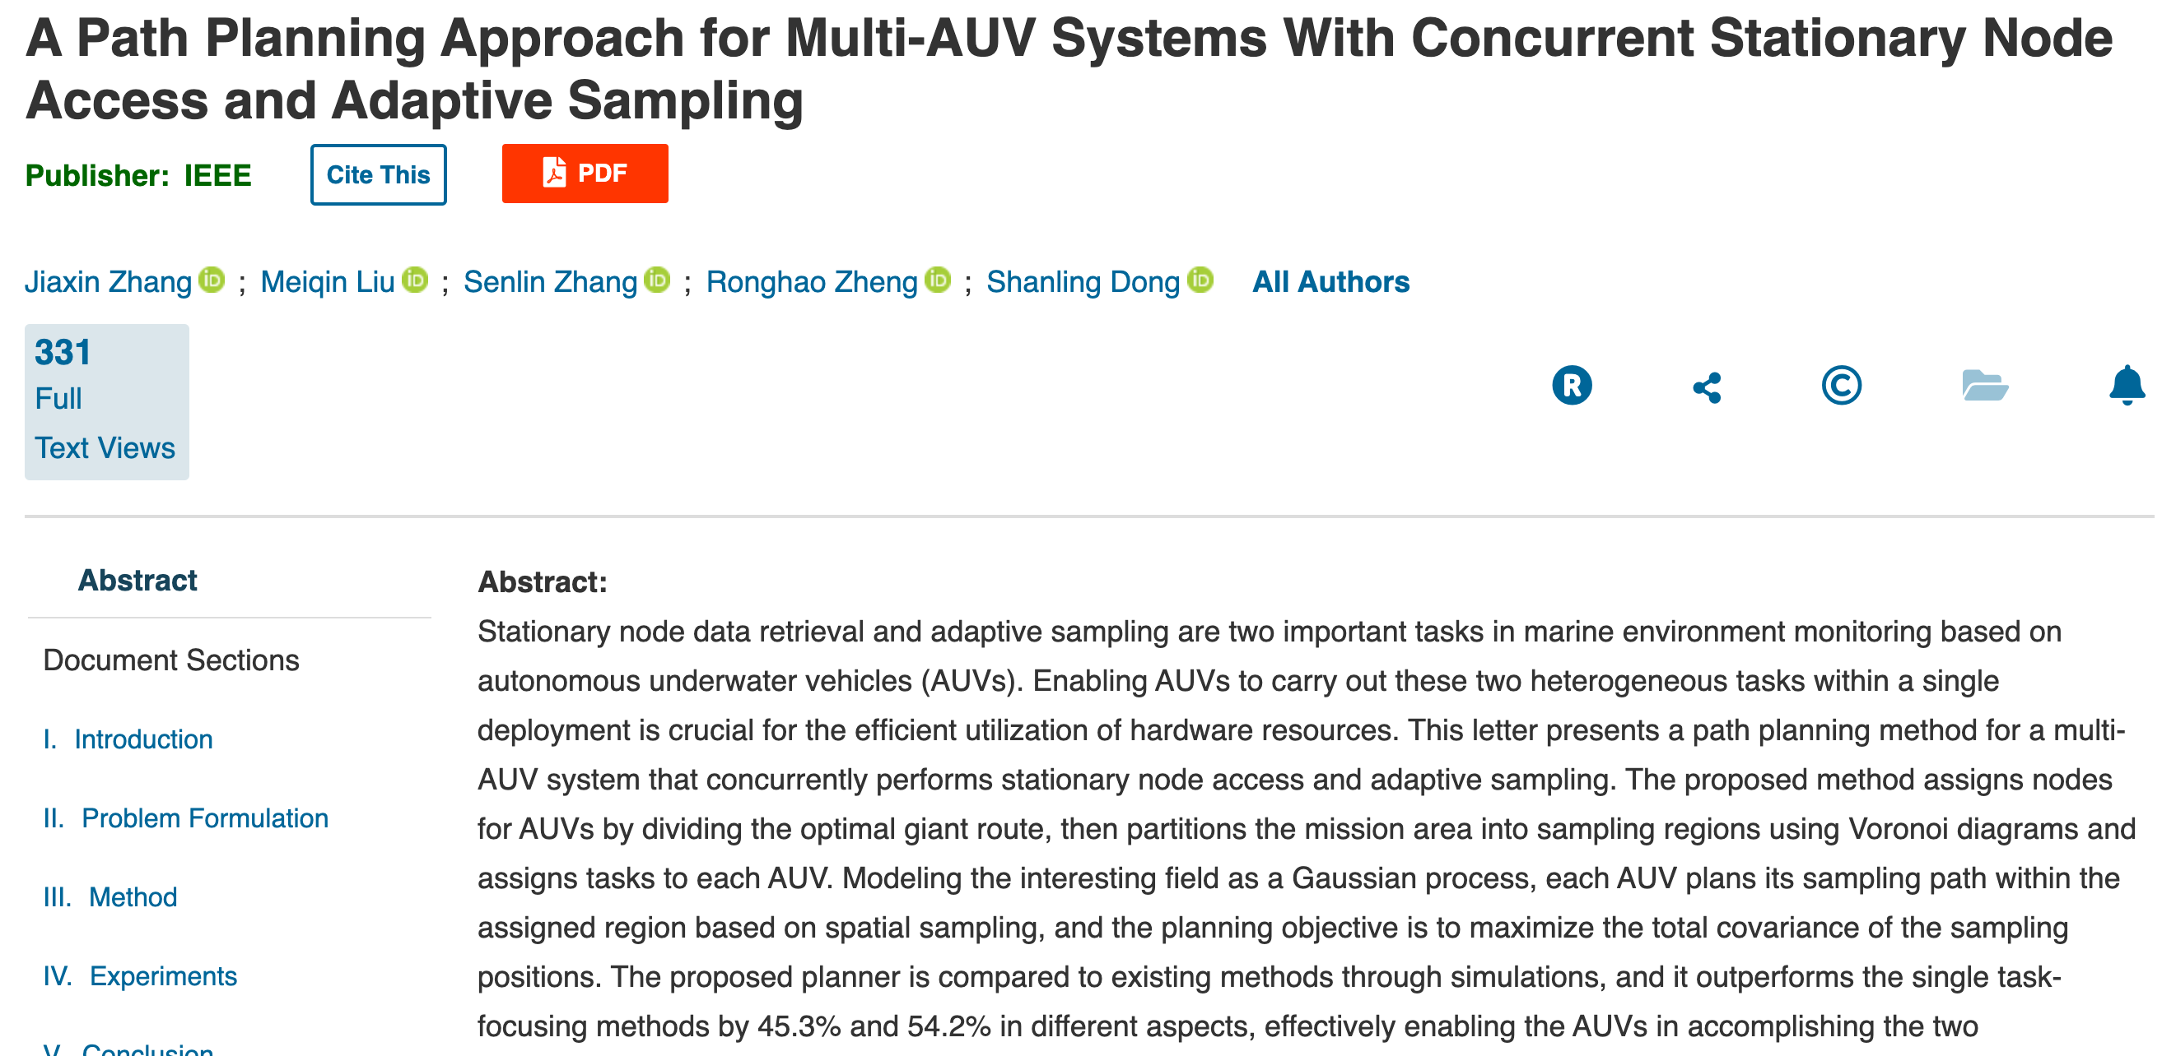
Case study II
Notes:
Published March 2024

Slide 26
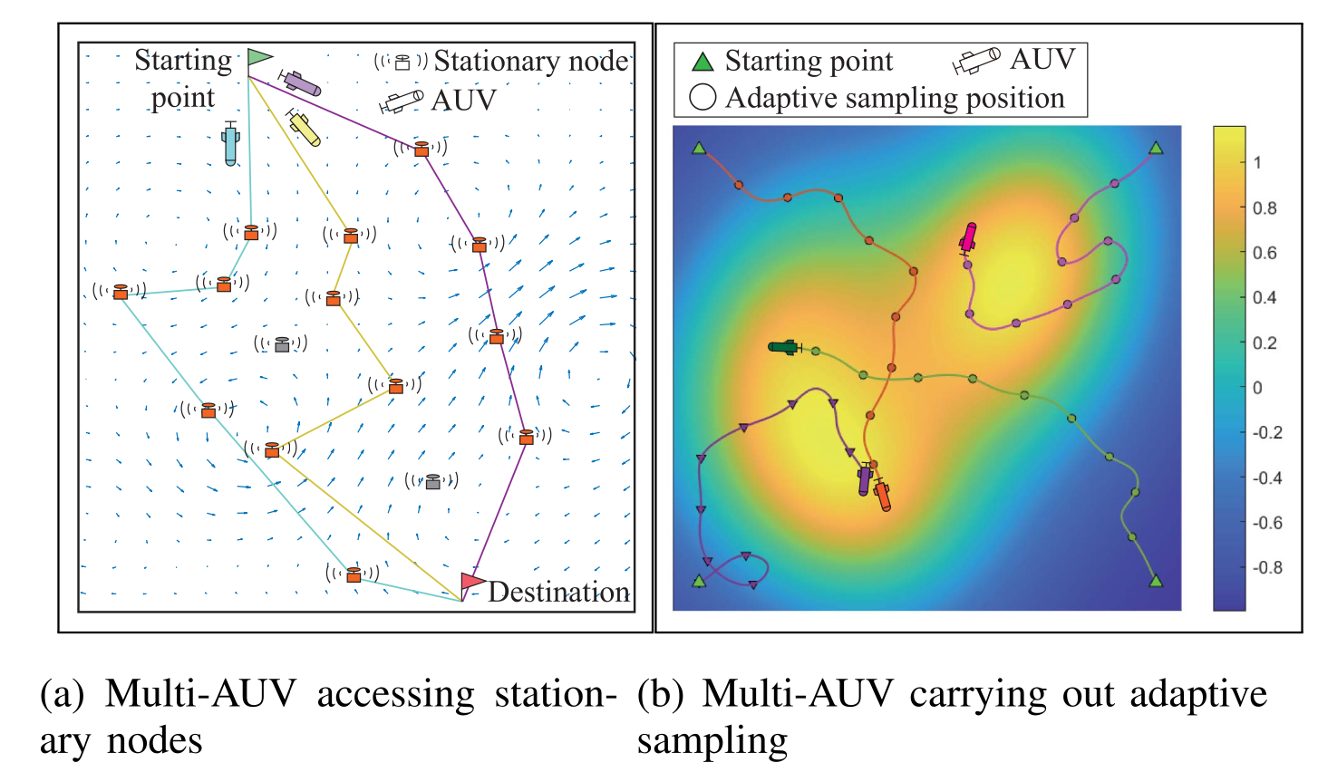
Case study II - Problem statement

Slide 27
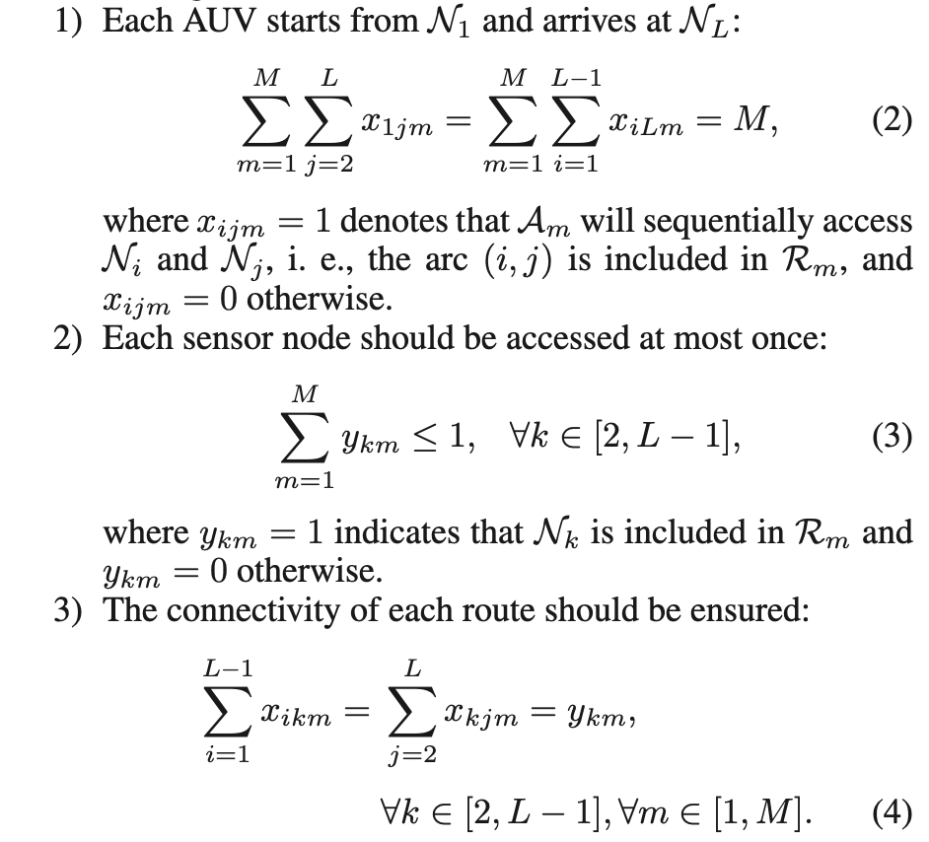
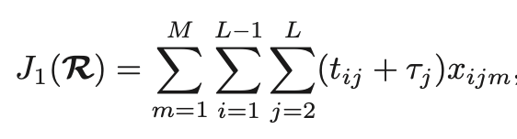
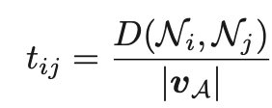
Case study II
Notes:
Tij: travel time
Tau – time spent to access that node

Slide 28
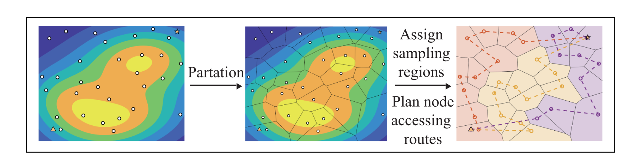
Case study II - Partitioning
Notes:
Generate a global partitioning first, then calculate the shortest path for one AUV, and then in the end, use GA to divide this giant route into small divisiions for more AUVs if applicable

Slide 29
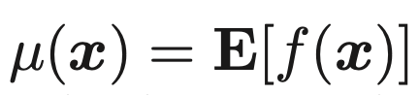
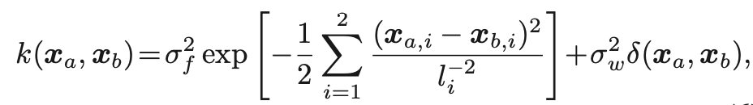
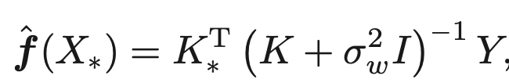
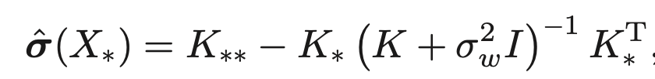
Case study II - Adaptive sampling
Gaussian Process for field kriging

Slide 30
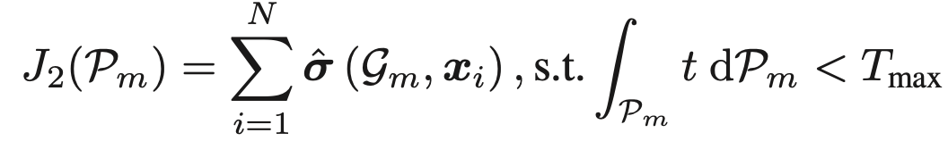

Case study II - Strategy

Slide 31


Case study II - Sampling

Slide 32

Case study II - Algorithm

Slide 33

Case study II - Simulation

Slide 34

Case study II - Benchmark
Notes:
FTRP: five tier route planner
ASPP: adaptive sampling path planner

Slide 35

Case study II - Simulation result

Slide 36

Case study II - Experiment setup

Slide 37

Case study II - Experiment result

Slide 38

Case study III
Lateral gradient detection
Upwelling front detection

Slide 39

Case study III

Slide 40

Case study III

Slide 41



Case study III - upwelling front detection
Notes:
Vertical temperature homogeneity index
AUV moving either from upwelling into stratiofied or vice versa

Slide 42

Case study III - historic data analysis
Notes:
To compare two methods: VTHI and lateral gradient, history data from May 1, 2017 is used
Warm, fresh to the west, cold salty to the east
Clearly a large gradient has been observed

Slide 43

Case study III - metric comparison

Slide 44



Slide 45
Future work
Improvements in AUV hardware and software
Enhanced communication and sensing capabilities
Machine learning for better adaptive sampling
Integrating big data sources such as AIS, satellite, buoys etc.

Slide 46
Conclusion
Oceanfronts are important for us
AUVs are flexibles to solve this problem
More AUV can help in certain ways, but its associated technical difficulty can be daunting to scale for now
AI can be a potential game changer

